Slide 2
To write a character description we need to:
Starter:
Describe what a character looks like?
What is an adjective?
What is a noun?
2. Describe how the character acts, speaks and moves.
What do we use to write actions?
What do we use to describe actions?

Slide 3
Verbs and Adverbs
The Verbs Song - YouTube
The Adverbs Song (NEW - 2019) - YouTube
What is a verb?
What is an adverb?

Slide 4
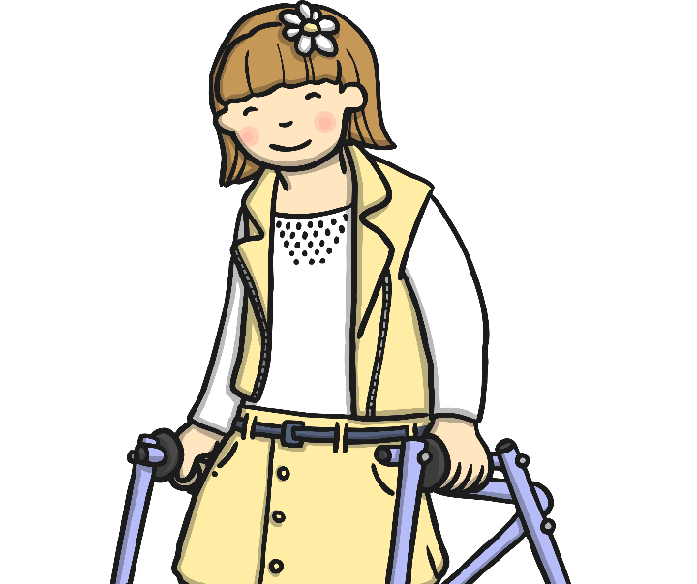
Most adverbs are made by adding the suffix ‘ly’ onto the end of the word.
kind + ly = kindly
careful + ly = carefully
Daniel coloured his picture carefully.
Lilly smiled kindly.

Slide 5
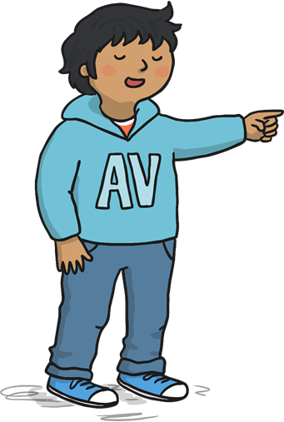
However, some adverbs describe where an action is happening.
Liam ran upstairs.
Can you choose one of these adverbs and use it in a sentence?
Here, ‘upstairs’ is describing where Liam ran, which makes it an adverb.
here
there
above

Slide 6
Some adverbs describe how an action is happening.
Helen laughed nervously.
Can you choose one of these adverbs and use it in a sentence?
Here, ‘nervously’ is describing how Helen laughed, which makes it an adverb.
quickly
loudly
sadly

Slide 7
Some adverbs describe when an action is happening.
The penguins swam yesterday.
Can you choose one of these adverbs and use it in a sentence?
Here, ‘yesterday’ is describing when the penguins swam, which makes it an adverb.
earlier
later
today

Slide 8
Some adverbs describe how often an action is happening.
The lion roared daily.
Can you choose one of these adverbs and use it in a sentence?
Here, ‘daily’ is describing how often the lion roars, which makes it an adverb.
weekly
always
sometimes

Slide 9
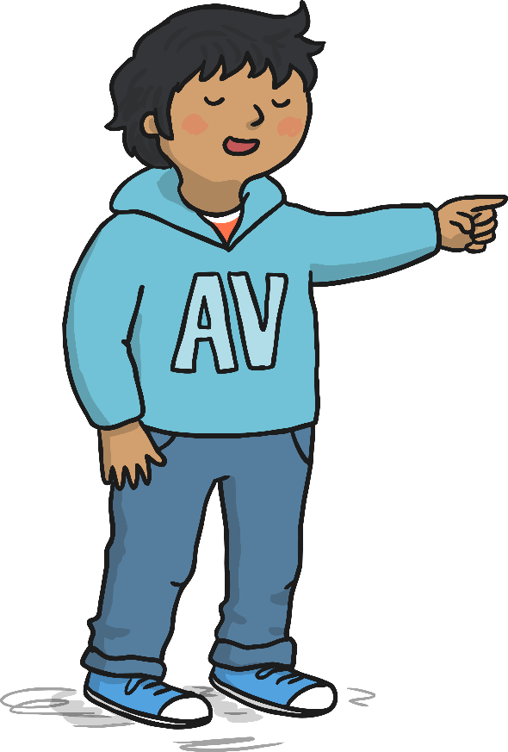
Spot the Adverbs
Tom painted his picture beautifully.
Annie quickly brushed her hair.
Amjid read his books today in the library.
Neena swam well without arm bands.
Ben always rides his bike to school.

Slide 10
Your Task:
Can you spot the verbs and adverbs in the sentences from Chapters 3 and 4.

