Slide 1
Length and Height
Starter:
What does length mean?
What unit of measurement do we use to measure length?

Slide 2
LO: Measuring length in cm.
We can use centimetres to measure shorter lengths.
How do we write centimetres?
What equipment can we use to measure in centimetres?

Slide 3
How do we use a ruler?
Why is it important to start measuring from 0?
Level 1
https://www.topmarks.co.uk/maths-games/measuring-in-cm

Slide 4
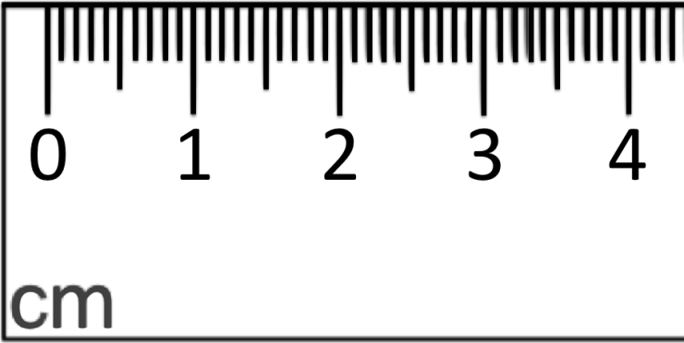
How many mm are in 1cm?
1cm = 10mm
Count the marks in between 0 and 1?
What do they represent?
Level 2
https://www.topmarks.co.uk/maths-games/measuring-in-cm

Slide 6
Our class text for 2 weeks: The BFG
In the silvery moonlight, the village street she knew so well looked completely different. The houses looked bent and crooked, like houses in a fairy tale.
Across the road she could see Mrs Rance’s shop…
There was a figure…
It stopped in front of every house.
The Giant had now stopped right in front of Mr and Mrs Goochey’s house. The Goochey’s had a greengrocers shop in the middle of the High Street, and the family lived above the shop.

Slide 7
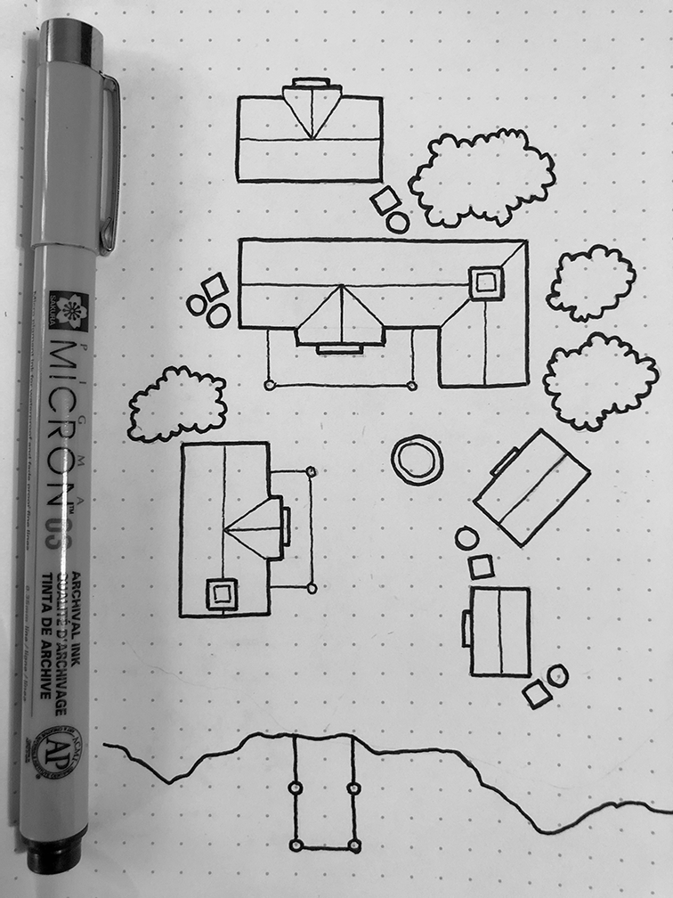
Your Task:
Can you measure the length of the buildings in the village that Sophie lives in?
Challenge:
Can you create your own map of an
imaginary village using a cm ruler?
Try to draw different lengths.

