Slide 1
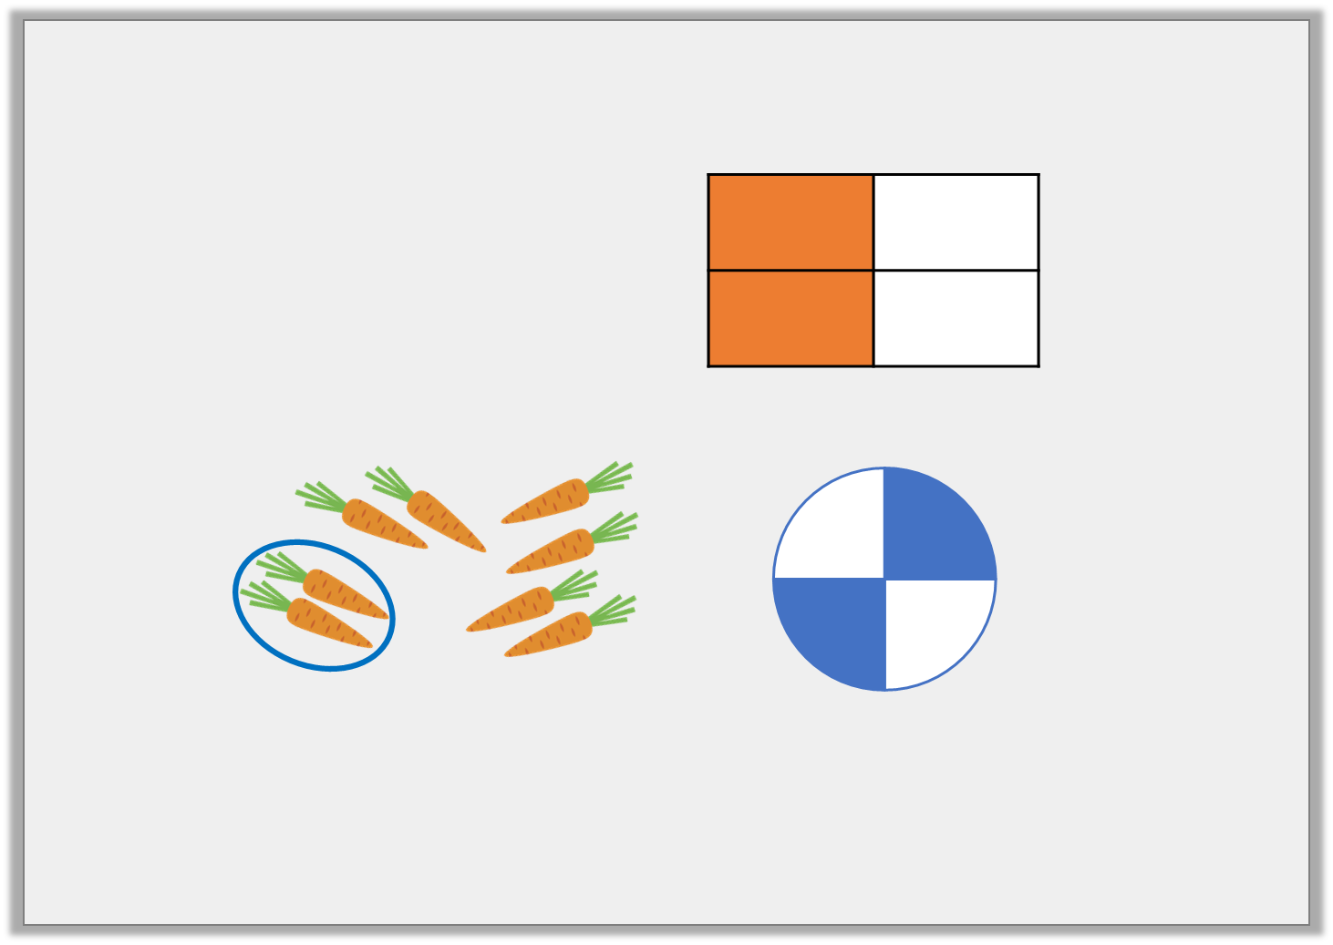
Starter:
Find the odd one out.
Explain your answer.
2
4
Notes:
Discuss equivalence

Slide 2
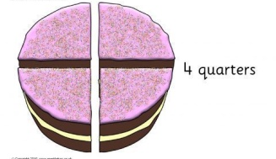
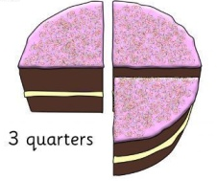
Notes:
Split cake into quarters, shade one, two and three quarters

Slide 3
Notes:
How many quarters make a whole? How many equal parts is 3 quarters? What has stayed the same and what changes?

