Slide 1
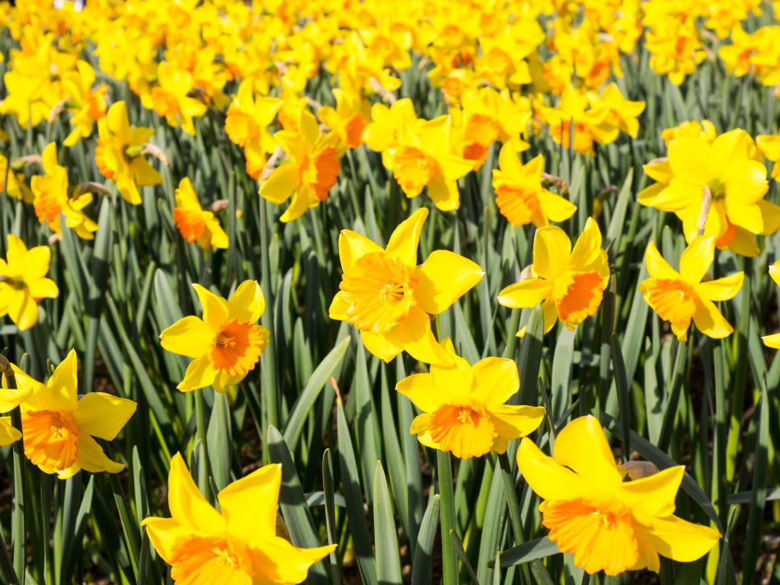
Daffodils by William Wordsworth
Poetry

Slide 2
Starter: Can you match the feature to the definition?
Rhyme
Repetition
Alliteration
When words start with the same sound.
Words that have the same sound
Repeated use of sounds, words or ideas for effect.

Slide 3
Simile:
What is a simile?
https://youtu.be/pm6zt24w0qU
Can you explain what a simile is in one sentence after watching the video?
Here is my answer.
A simile is compares two things to show the what is similar between the two - a simile will include the words "like" or "as

Slide 4
Task- Can you find any similes in ‘Daffodils’?
Highlight and label them on your copy of the poem.
I wandered as lonely as a cloud.
- The speaker compares his loneliness to a single cloud.
Continuous as the stars that shine.
- The speaker compares an endless row of daffodils to shining stars.
Answers

Slide 5
Task
Go on a hunt around your house or garden.
Can you write your own similes about things?

