Slide 1
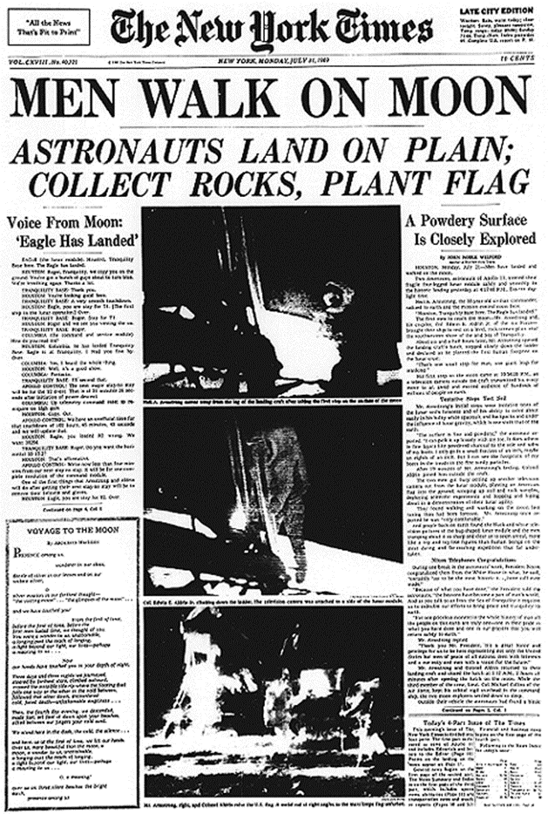
Newspaper Report
Starter:
What is the purpose of writing a newspaper report?
Can you remember any features of a newspaper report?
Notes:
To inform readers of what is happening worldwide

Slide 2
Features of a Newspaper Report
https://www.bbc.co.uk/bitesize/topics/z2yycdm/articles/z2gk9qt
Notes:
Headline,

Slide 3
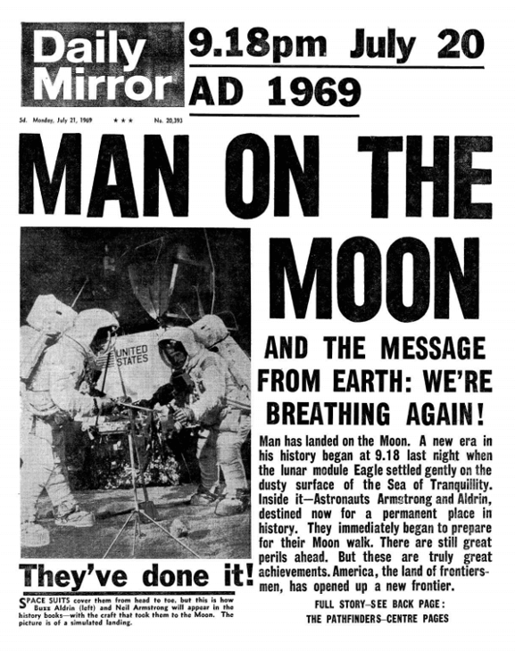
Let’s list the features together…
Notes:
Headline, name of newspaper, pictures with captions, facts about the main events in chronological order, subtitles sometimes, introductory paragraph (covers the 5Ws), third person and past tense, conclusion paragraph to explain what might happen next, paragraphs, comments from interviews and reactions
Past tense- something that has already happened – Can you find any past tense verbs? (Verbs are words used to describe an actions) example: landed

Slide 4
Your Task:
Can you label the features of the newspaper report?

Slide 5
Challenge
Why do newspaper reports use headlines?
Why is there a introductory paragraph?
Why do newspaper reports have paragraphs?
What is the purpose of a caption?
What does opinion mean?

Slide 6
Make your headline short and snappy.
In the first sentence sum up what the story is about.
Write your report in the third person and the past tense.
Split your newspaper report up into paragraphs to help the reader clearly understand the information.
If you use quotes to make your report more interesting, don't forget to use speech marks!
Use a photo with a caption to give the reader more information.
Fill your newspaper report with both facts and opinions. Facts give the reader all of the information they need by using the 5 Ws.
Notes:
Headline, name of newspaper, pictures with captions, facts about the main events in chronological order, subtitles sometimes, introductory paragraph (covers the 5Ws), third person and past tense, conclusion paragraph to explain what might happen next, paragraphs, interview comments and reactions from people

