Slide 1
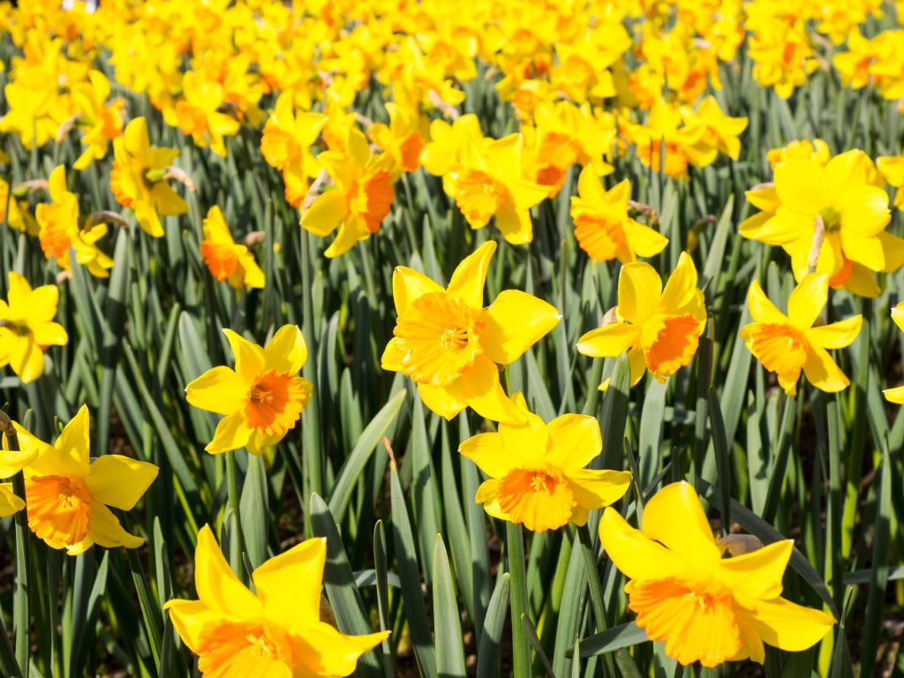
Daffodils by William Wordsworth
Poetry

Slide 2
Starter:
Can you retell the poem?
What is the main theme of our poem?
How does the speaker’s mood change throughout?
What is your favourite part of the poem?

Slide 3
Rhyme Scheme: A,B,A,B,C,C
What is a rhyme scheme? - BBC Bitesize
I wandered lonely as a cloud A That floats on high o'er vales and hills, B When all at once I saw a crowd, A A host, of golden daffodils; B Beside the lake, beneath the trees, C Fluttering and dancing in the breeze. C
Alternate Rhyme – A,B,A,B (First and third lines rhyme and second and fourth lines rhyme)
Rhyming Couplet – C,C (Lines that follow on from eachother where the final words of each line rhyme)

Slide 4
Repetition
What is repetition? - BBC Bitesize
Task:
Are any words repeated in ‘Daffodils’?
Why do you think the words are repeated?
3rd Stanza- poet repeats the word ‘gazed’ twice.
The word ‘dance’ is repeated 3 times in the poem.
The repetition of ‘gazed’ could show how much the speaker loved looking at the daffodils.
The repetition of ‘dance’ shows the happiness and liveliness of the flowers.

Slide 5
Alliteration
What is alliteration? - BBC Bitesize
Alliteration is when words start with the same sound:
Example: Sammy the slippery snake came sliding.
Beside the lake, beneath the trees,
What wealth the show to me had brought:
And dances with the daffodils.

Slide 6
Task

Slide 7
Challenge:
Can you write your own stanza with the same rhyme scheme as Daffodils?
It can be about anything you want.
Can you include Repetition or Alliteration?

