Slide 1
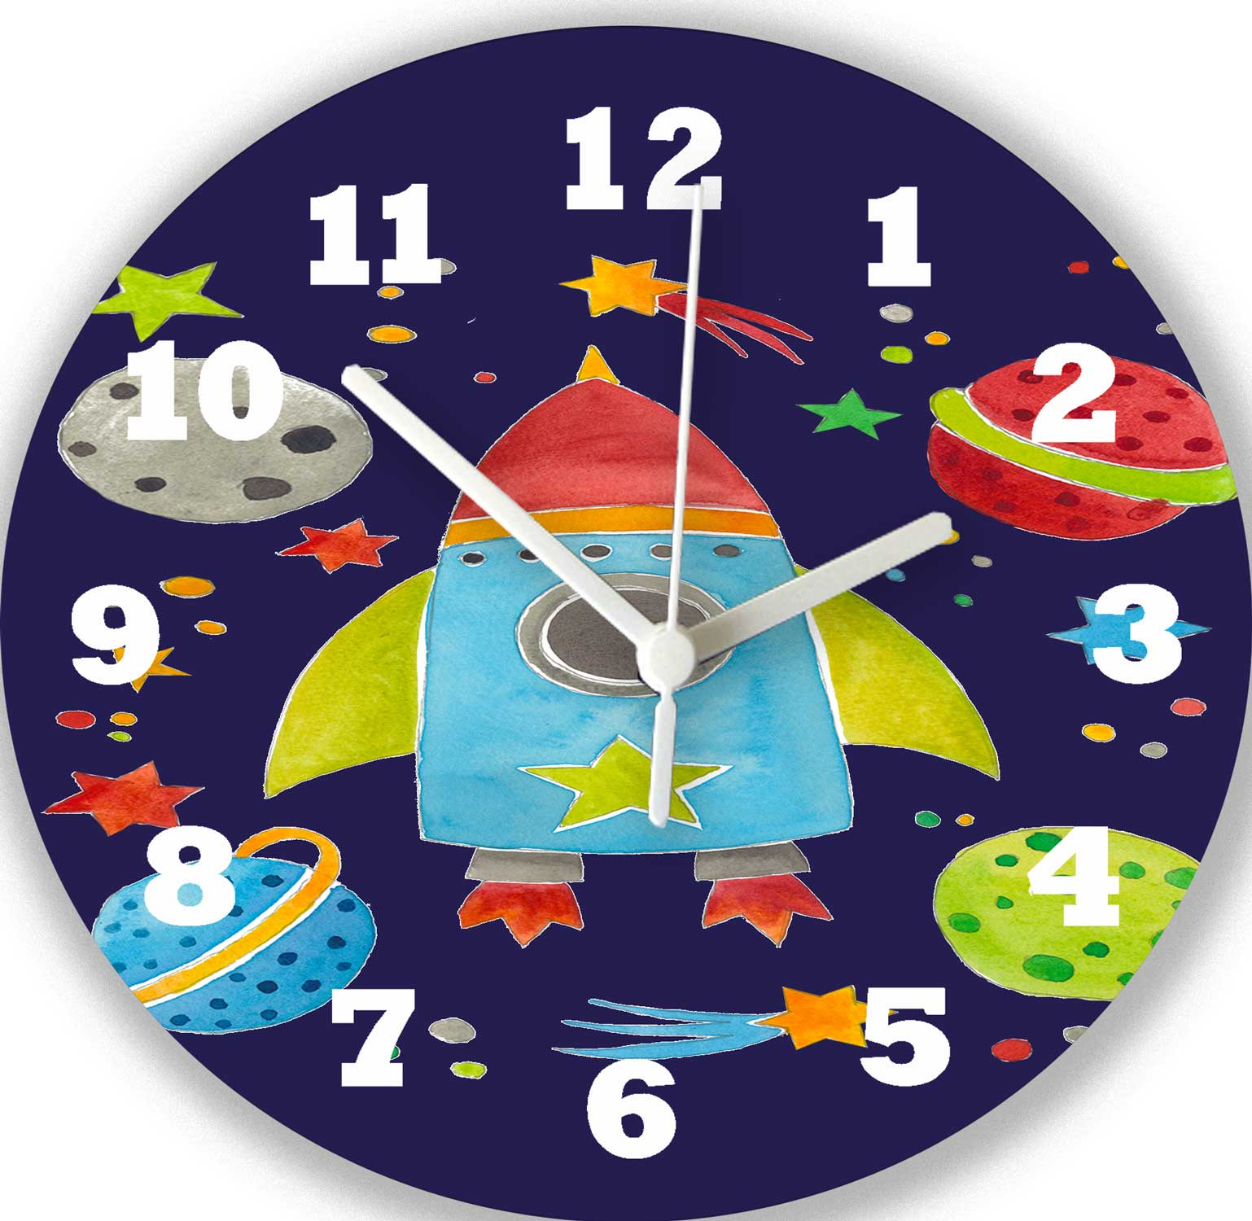
Time Adverbials

Slide 2
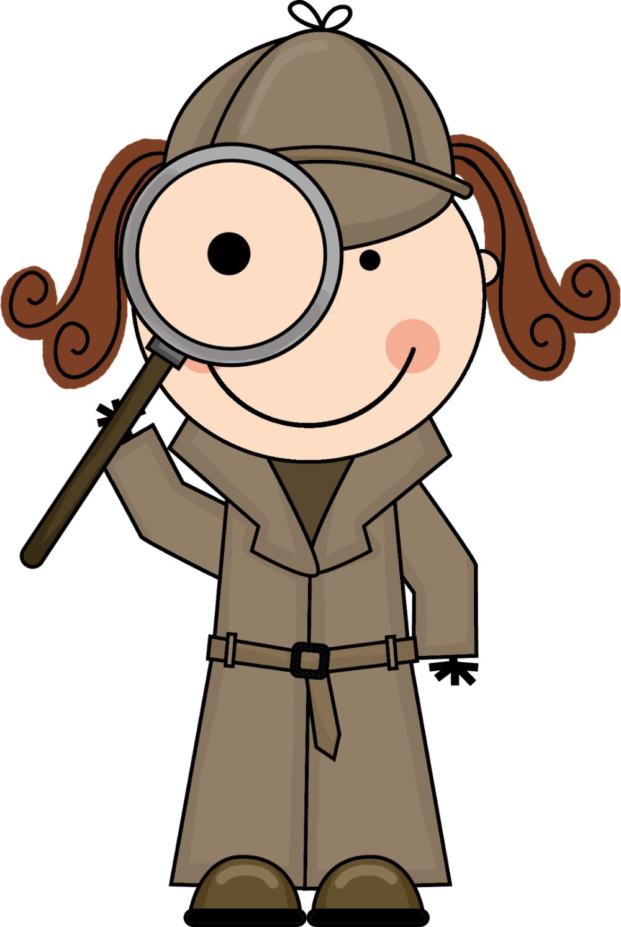
What is a Time Adverbial?
Time adverbials tell us when an action happened.
Can you be a time adverbial detective?
This morning, I had toast for breakfast. Afterwards, I had a glass of orange juice. Finally, I brushed my teeth.

Slide 3
Can you spot any Time Adverbials in this song?
https://www.youtube.com/watch?v=seaeluxIsqw

Slide 4
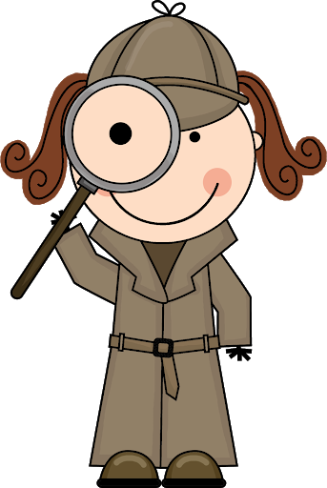
Your Task:
You are going to be a time adverbial detective. Get your magnifying glasses ready.
How many can you spot?
Highlight the time adverbials. Make a bank or list of them. You could use them in your newspaper report.
Challenge: Can you research and find any more time adverbials?
Can you write a paragraph about your day using time adverbials?

Slide 5
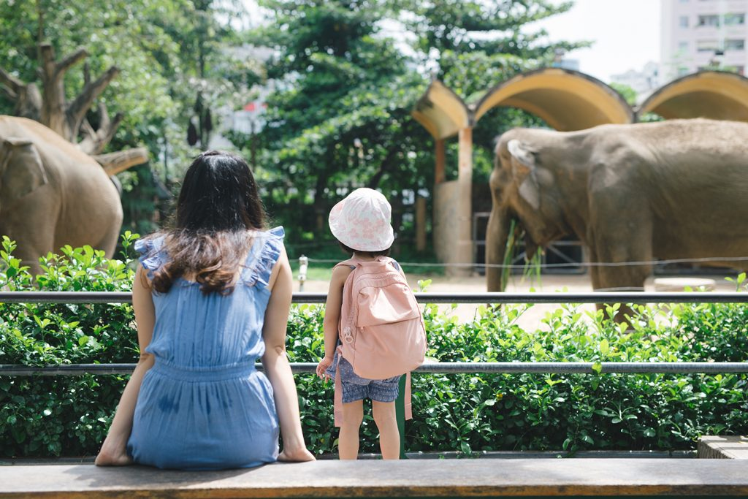
Yesterday, I went to the zoo with my friend. Firstly, we bought our tickets. In that moment, I was really excited to see the penguins! I loved watching them dive into the water. After that we moved onto the butterfly house and it was really warm inside. Next we had some lunch. Later on we had an ice cream. Before long it was time to go back to the car. Finally home time!
Last Tuesday, I got up early and went to the airport. A few hours later, I was on my way to Spain. Once we arrived we went straight to a lovely restaurant to begin with. We were enjoying our meal. All of a sudden a wonderful band started to play. Immediately, we were excited and started to dance. Soon after that, we went shopping. After a while, we got tired and returned to our hotel. In the end we had a brilliant holiday and we would love to go back.

