Slide 1
Subtract 10 from any number

Slide 2
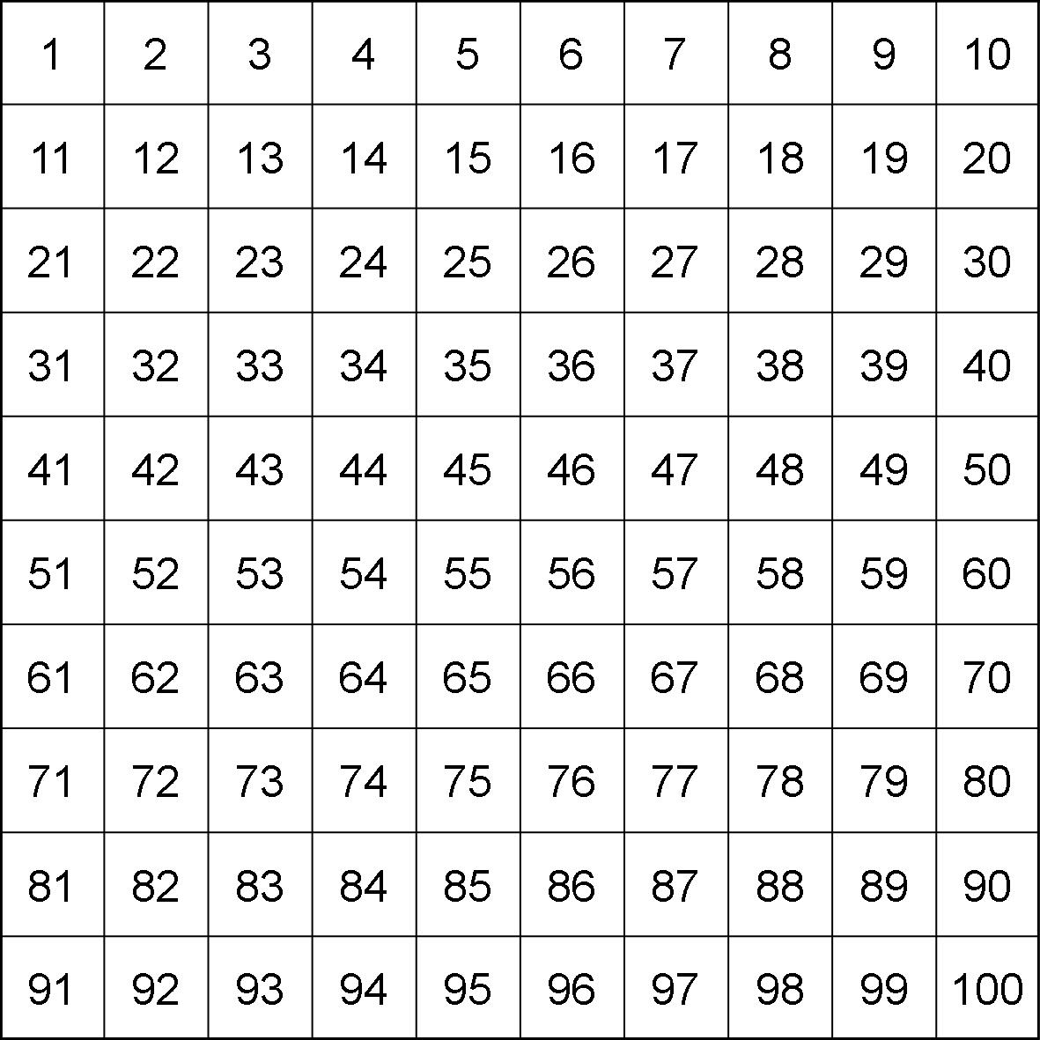
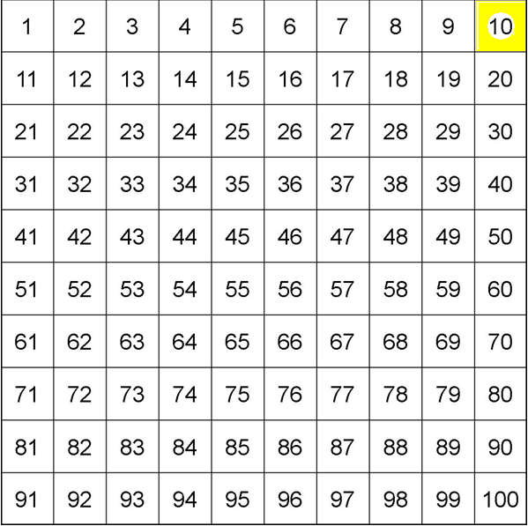
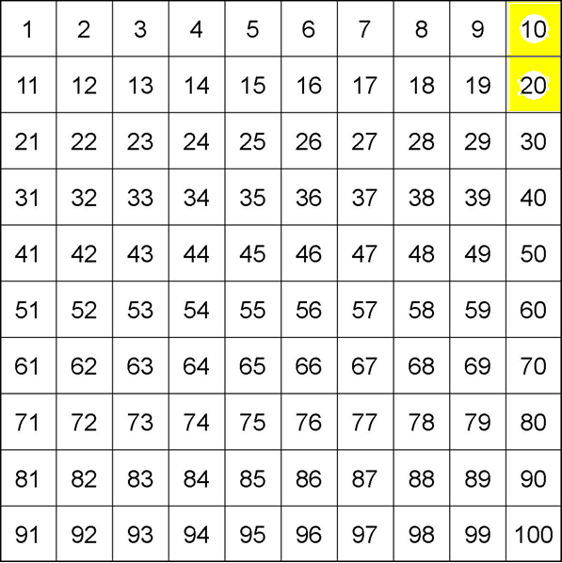
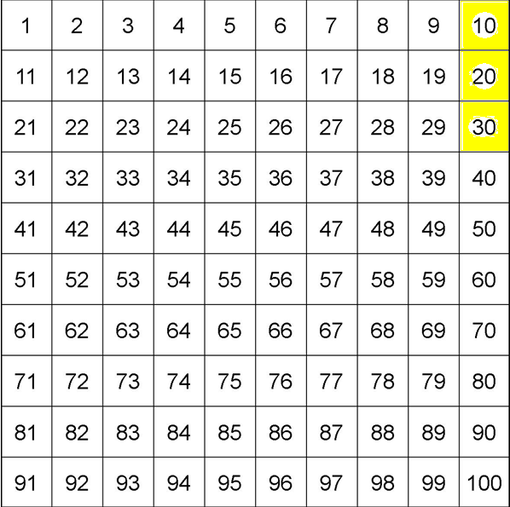
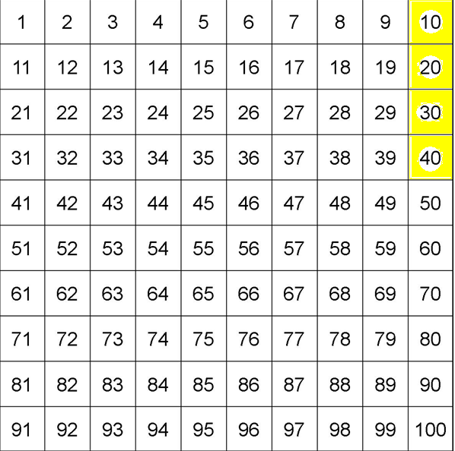
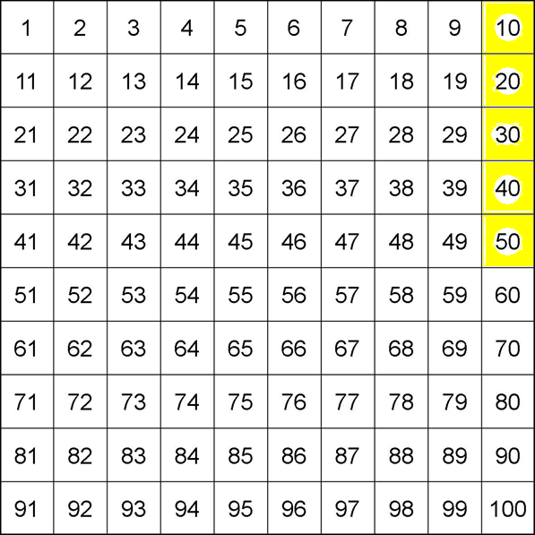
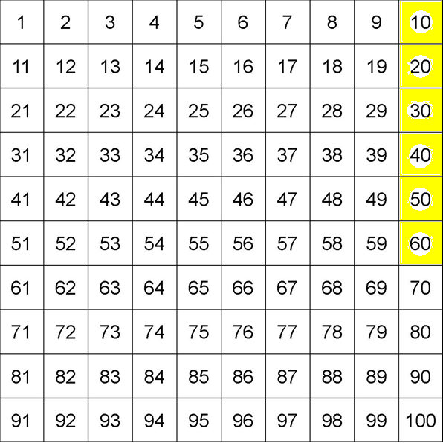
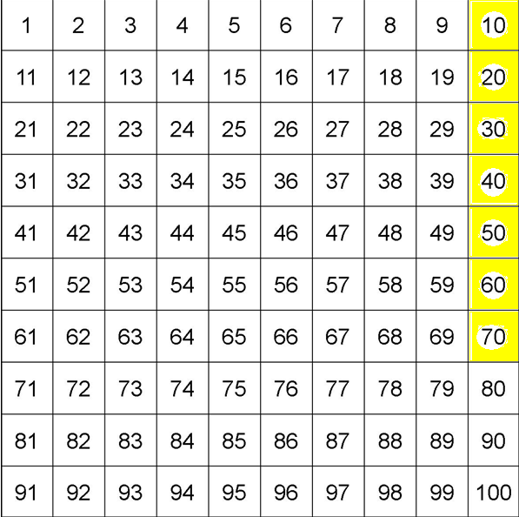
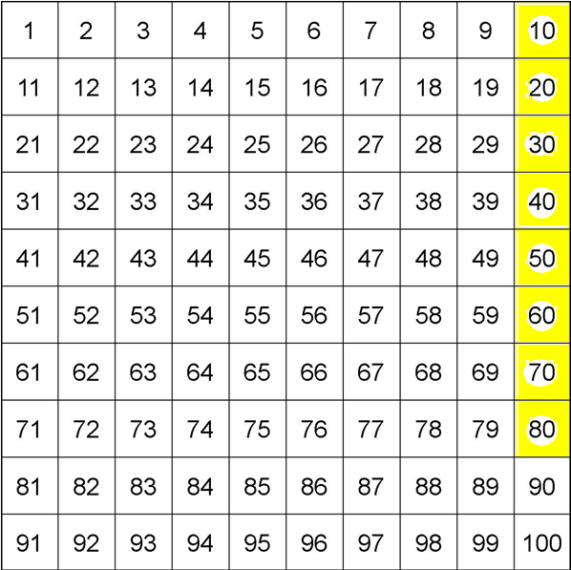
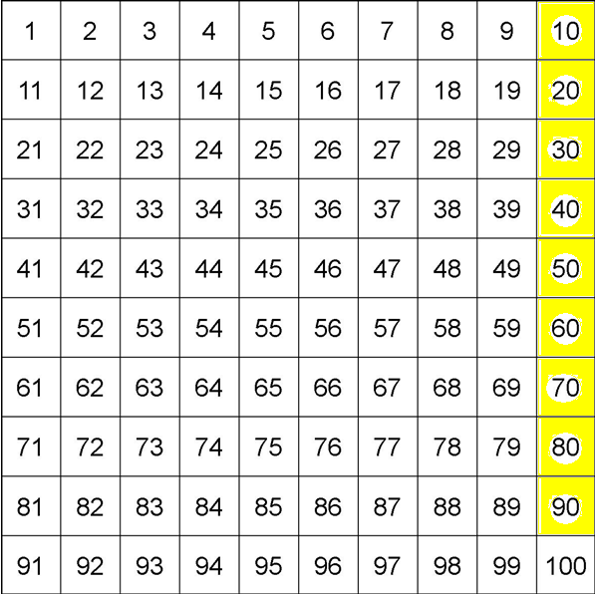
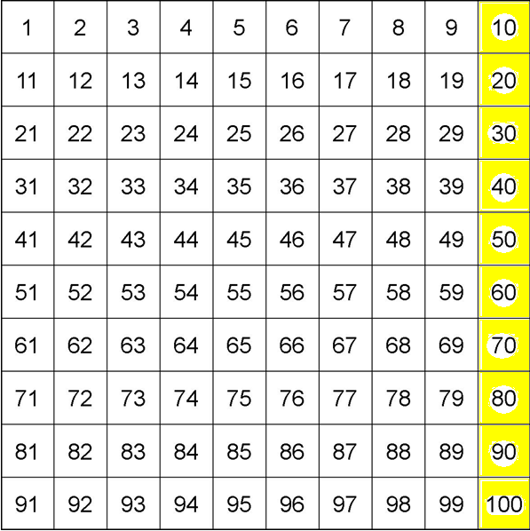
10 times table

Slide 3
T- Tens
O- Ones
T 0
T 0
2 2 - 1 0 = ?
1. Subtract the tens
2. Subtract the ones
20 - 10 = 10
2 - 0 = 2
3. Add the two answers together
10 + 2 = 12

Slide 4
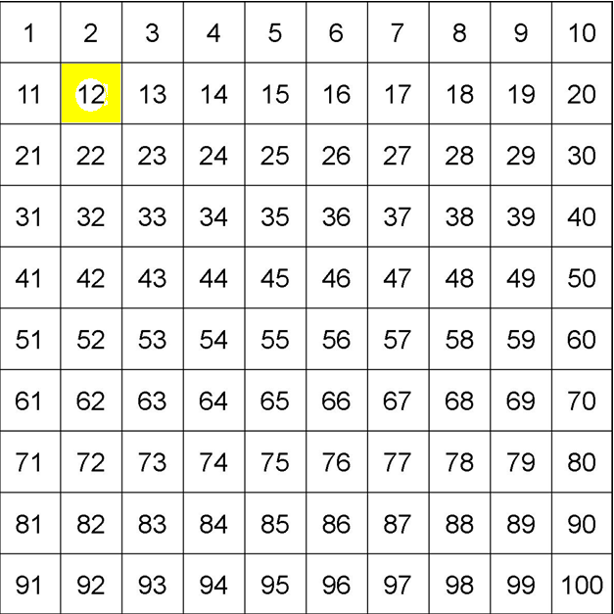
22 - 10 = 12
2
12
Can you spot a pattern when you subtract 10?
Does the tens number change?
Do the ones stay the same?
22
32
42

Slide 5
T- Tens
O- Ones
T 0
T 0
34 - 1 0 = ?
1. Subtract the tens
2. Subtract the ones
30 - 10 = 20
4 - 0 = 4
3. Add the two answers together
20 + 4 = 24

Slide 6
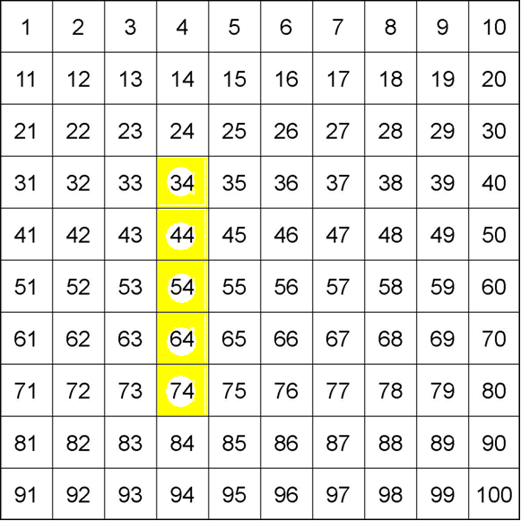
34 - 10 = 24
14
When you subtract ten you need to take one away from the tens. The ones stay the same.
24
34
44
54
64
74

