Slide 1
LIFE/work balance
We have started a #LIFEworkbalance campaign and we need your help to complete our LIFE/work balance survey.
We hope to publish the results soon, so please give 15 minutes of your time to help us get a true picture of school life.
Want to be a part of this campaign? Take the survey on our website and share it with your colleagues!
© Classroom Secrets Limited 2019

Slide 2
Year 2 – Autumn Block 1 – Place Value – Tens and Ones 1
About This Resource:
This PowerPoint has been designed to support your teaching of this small step. It includes a starter activity and an example of each question from the Varied Fluency and Reasoning and Problem Solving resources also provided in this pack. You can choose to work through all examples provided or a selection of them depending on the needs of your class.
National Curriculum Objectives:
Mathematics Year 2: (2N3) Recognise the place value of each digit in a two-digit number (tens, ones)
Mathematics Year 2: (2N4) Identify, represent and estimate numbers using different representations, including the number line
Mathematics Year 2: (2N6) Use place value and number facts to solve problems
More Year 2 Place Value resources.
Did you like this resource? Don’t forget to review it on our website.
© Classroom Secrets Limited 2018

Slide 3
Year 2 – Autumn Block 1 – Place Value
Step 3: Tens and Ones 1
© Classroom Secrets Limited 2018

Slide 4
Introduction
I’m thinking of a two digit number.
If you add the digits together, they make 7.
What number am I thinking of?
© Classroom Secrets Limited 2018

Slide 5
Introduction
I’m thinking of a two digit number.
If you add the digits together, they make 7.
What number am I thinking of?
The number could be:
16 (1 + 6 = 7)
25 (2 + 5 = 7)
34 (3 + 4 = 7)
43 (4 + 3 = 7)
52 (5 + 2 = 7)
61 (6 + 1 = 7)
70 (7 + 0 = 7)
© Classroom Secrets Limited 2018

Slide 6
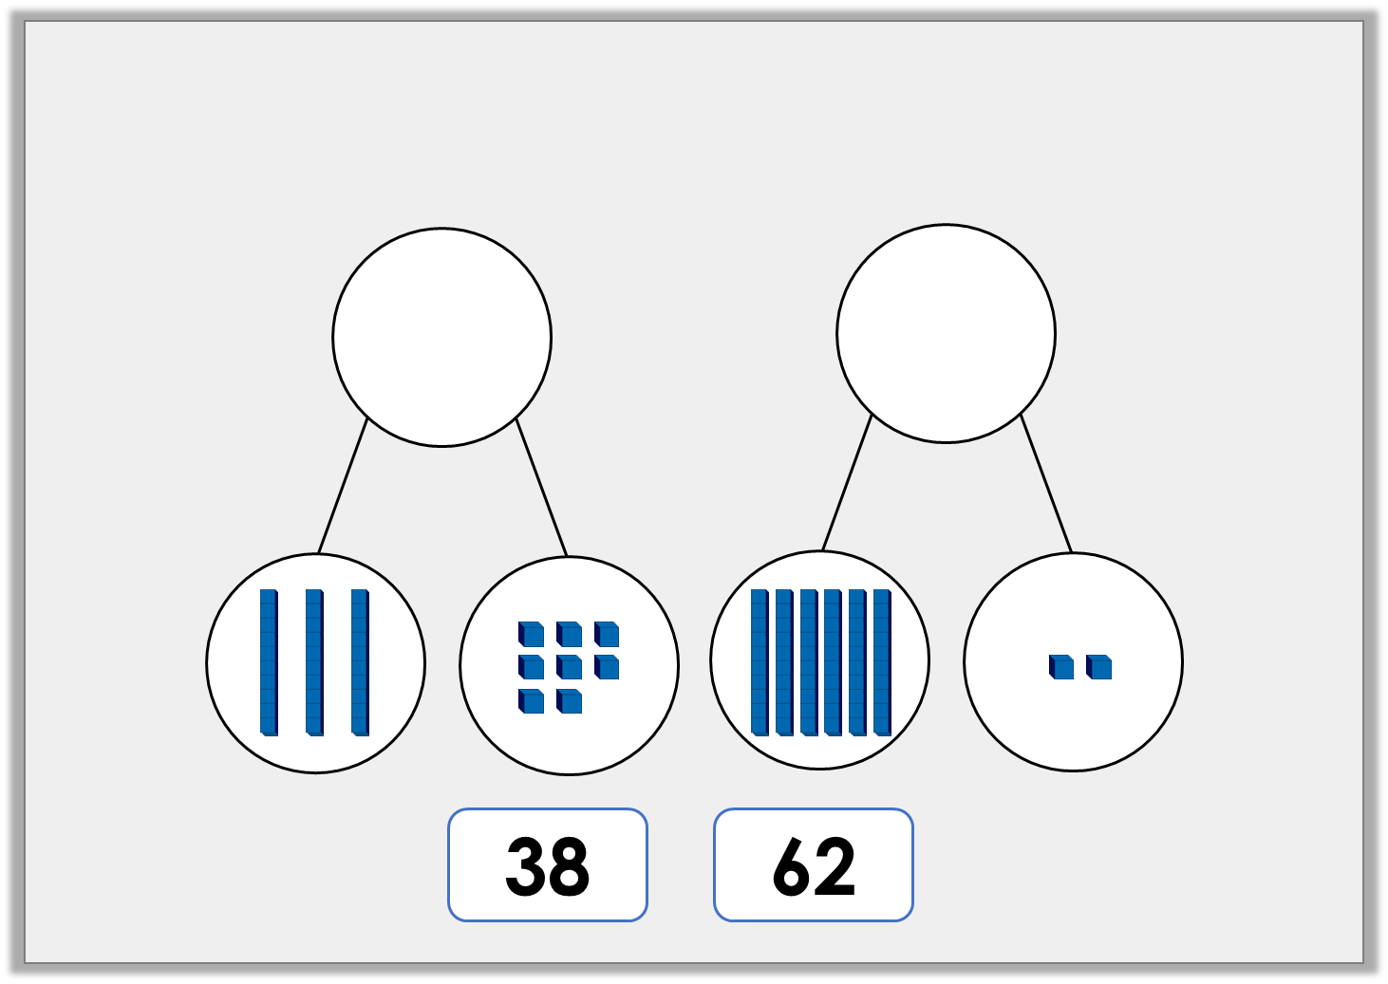
Varied Fluency 1
Use the number cards to complete the part whole models.
© Classroom Secrets Limited 2018

Slide 7
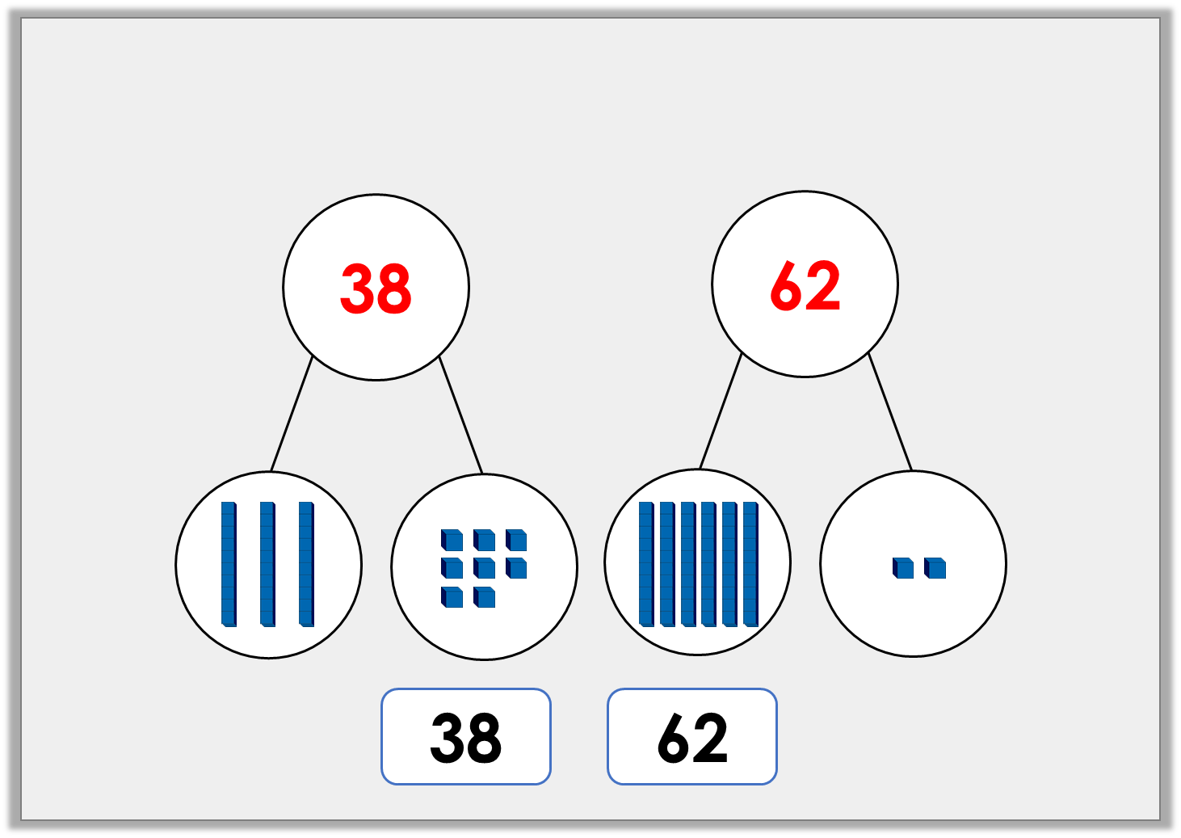
Varied Fluency 1
Use the number cards to complete the part whole models.
© Classroom Secrets Limited 2018

Slide 8
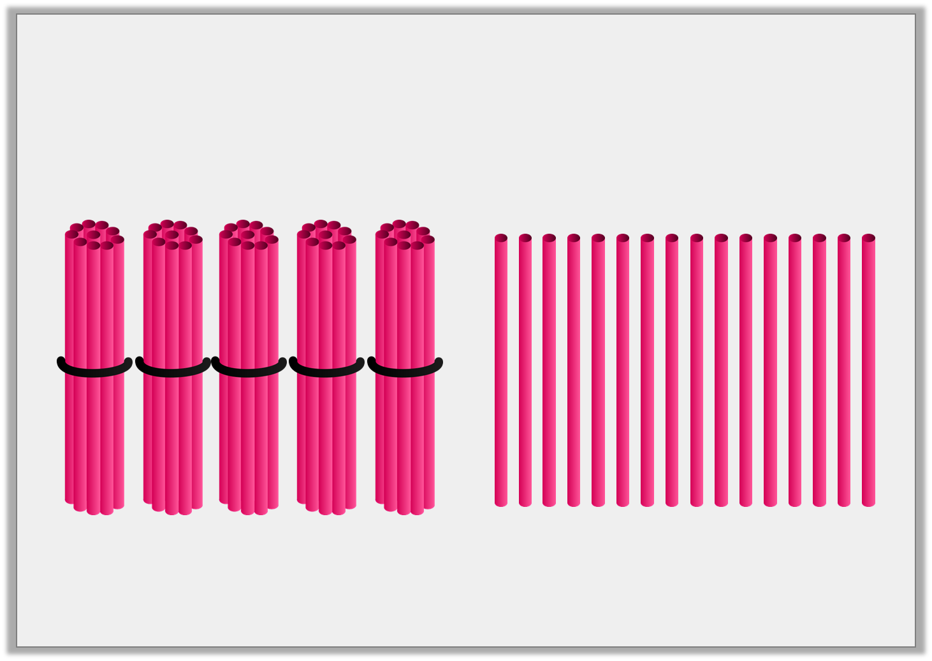
Varied Fluency 2
True or false? The number 56 can be partitioned into 5 tens and 16 ones.
© Classroom Secrets Limited 2018

Slide 9
Varied Fluency 2
True or false? The number 56 can be partitioned into 5 tens and 16 ones.
False; 5 tens and 6 ones, or 4 tens and 16 ones
© Classroom Secrets Limited 2018

Slide 10
Varied Fluency 3
Use the place value counters to complete the partitioning of 82.
10
10
10
10
10
10
10
10
1
1
10
10
10
10
10
10
10
10
10
10
10
10
10
1
1
10
1
1
1
10
10
10
10
10
10
10
10
10
10
© Classroom Secrets Limited 2018

Slide 11
Varied Fluency 3
Use the place value counters to complete the partitioning of 82.
10
10
10
10
10
10
10
10
1
1
10
10
10
10
10
10
10
10
10
10
10
10
10
1
1
10
10
10
10
10
1
1
10
10
10
10
10
1
1
1
10
10
10
10
10
10
10
10
1
1
10
10
10
© Classroom Secrets Limited 2018

Slide 12
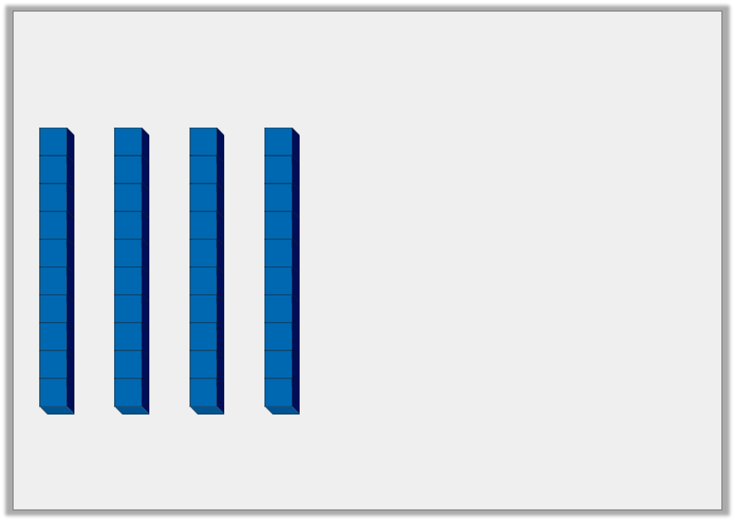
Varied Fluency 4
Draw the ones needed to make 57.
© Classroom Secrets Limited 2018

Slide 13
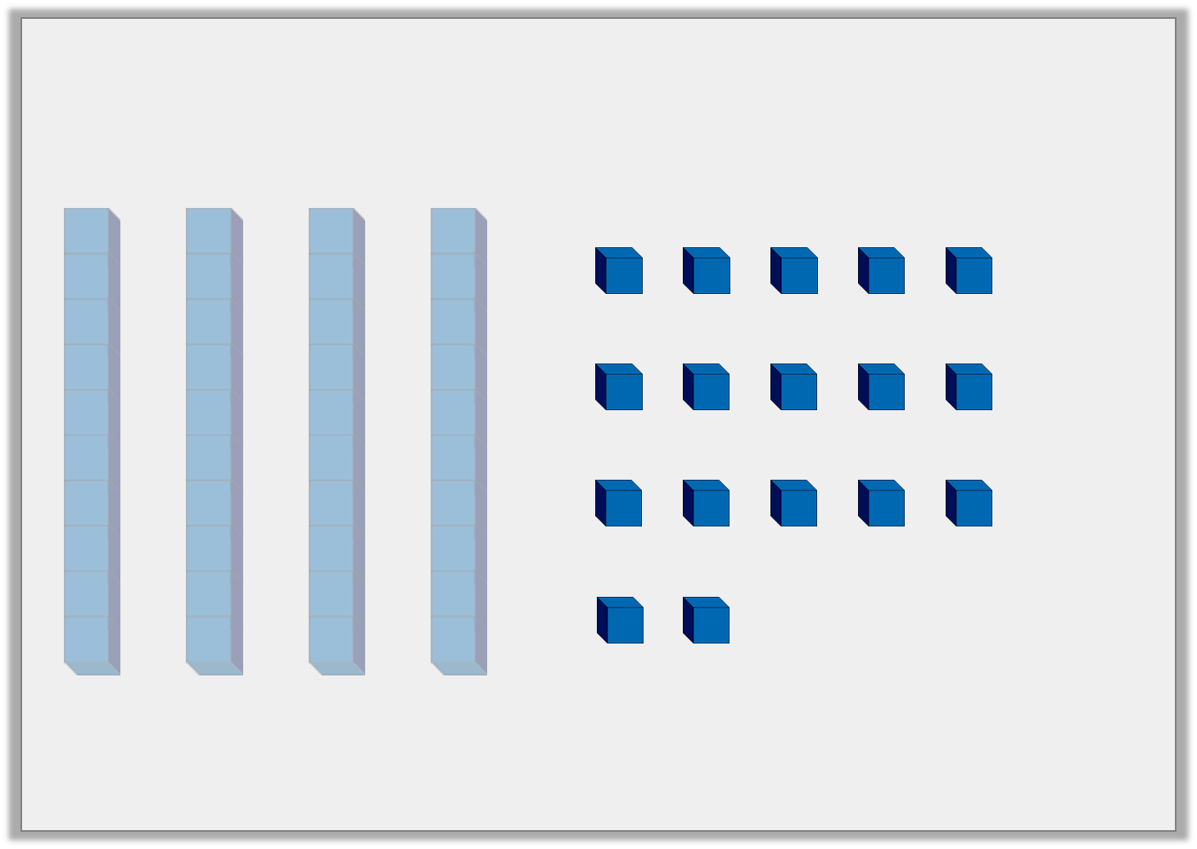
Varied Fluency 4
Draw the ones needed to make 57.
17 ones
© Classroom Secrets Limited 2018

Slide 14
Problem Solving 1
Lorena is partitioning the number 84. Finish her sentence and use place value counters to complete the partition.
6 tens and
___ tens and ___ ones
3 tens and
___ tens and ___ ones.
10
10
10
and
and
10
10
10
10
10
10
© Classroom Secrets Limited 2018

Slide 15
Problem Solving 1
Lorena is partitioning the number 84. Finish her sentence and use place value counters to complete the partition.
6 tens and
3 tens and
2 tens and 4 ones
5 tens and 4 ones
10
10
10
1
10
10
10
1
and
and
10
10
10
1
10
10
10
1
10
10
1
1
10
10
1
1
© Classroom Secrets Limited 2018

Slide 16
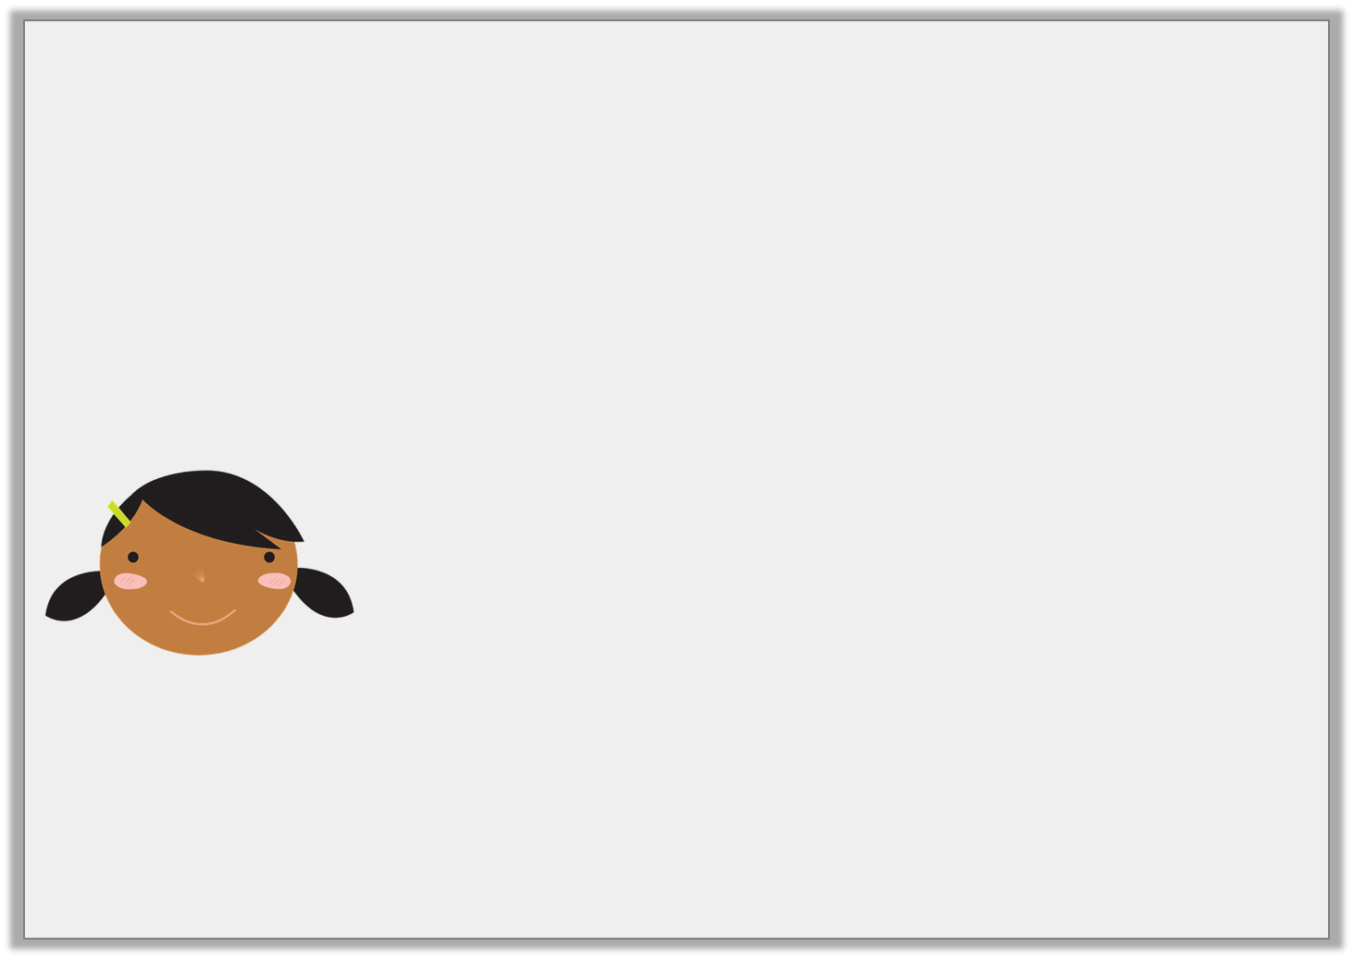
Reasoning 1
Meena has created a whole part model of 38.
Is she correct? Explain your answer.
8
38
3
© Classroom Secrets Limited 2018

Slide 17
Reasoning 1
Meena has created a whole part model of 38.
Is she correct? Explain your answer.
Meena is incorrect because...
8
38
3
© Classroom Secrets Limited 2018

Slide 18
Reasoning 1
Meena has created a whole part model of 38.
Is she correct? Explain your answer.
Meena is incorrect because she has split the digits instead of partitioning. The digit 3 is worth 30 so the parts should be 30 and 8.
8
38
3
© Classroom Secrets Limited 2018

Slide 19
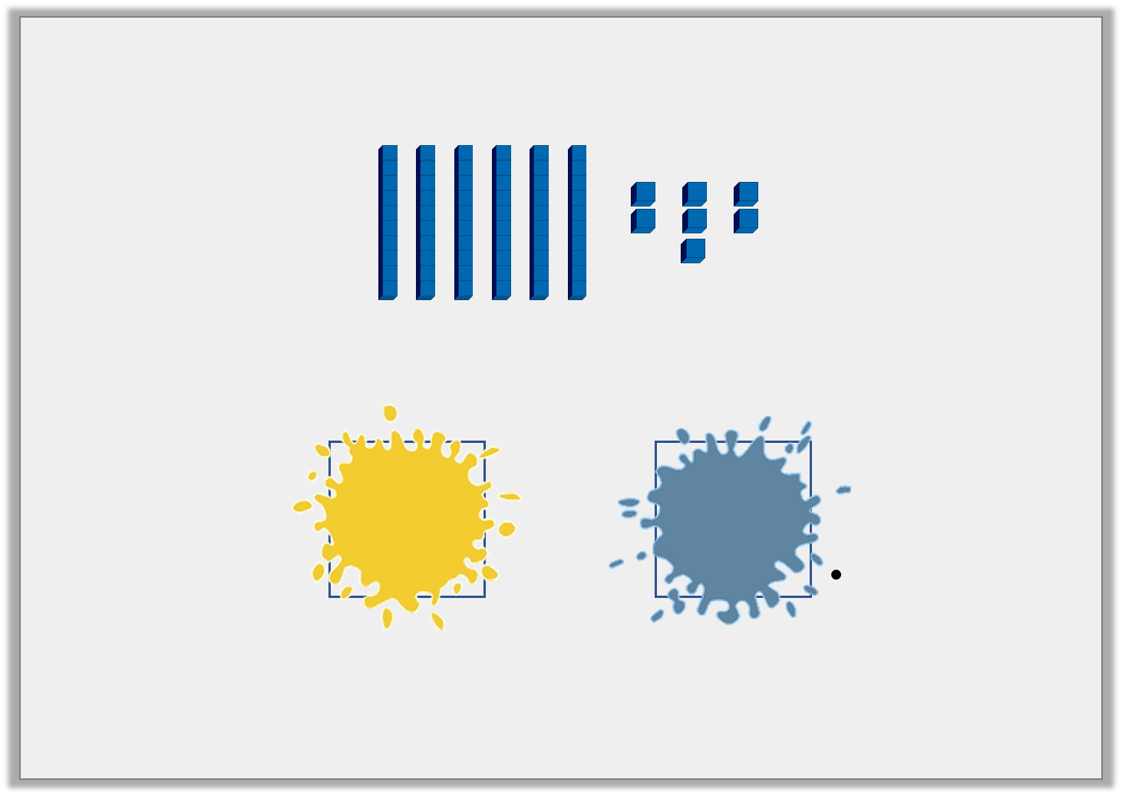
Problem Solving 2
Hugh has spilled paint on his work.
Find 3 combinations that could complete the statement above.
67
can be partitioned into
and
© Classroom Secrets Limited 2018

Slide 20
Problem Solving 2
Hugh has spilled paint on his work.
Find 3 combinations that could complete the statement above.
Various answers, for example: 20 and 47; 10 and 57 and 60 and 7.
67
can be partitioned into
and
© Classroom Secrets Limited 2018

