Slide 1
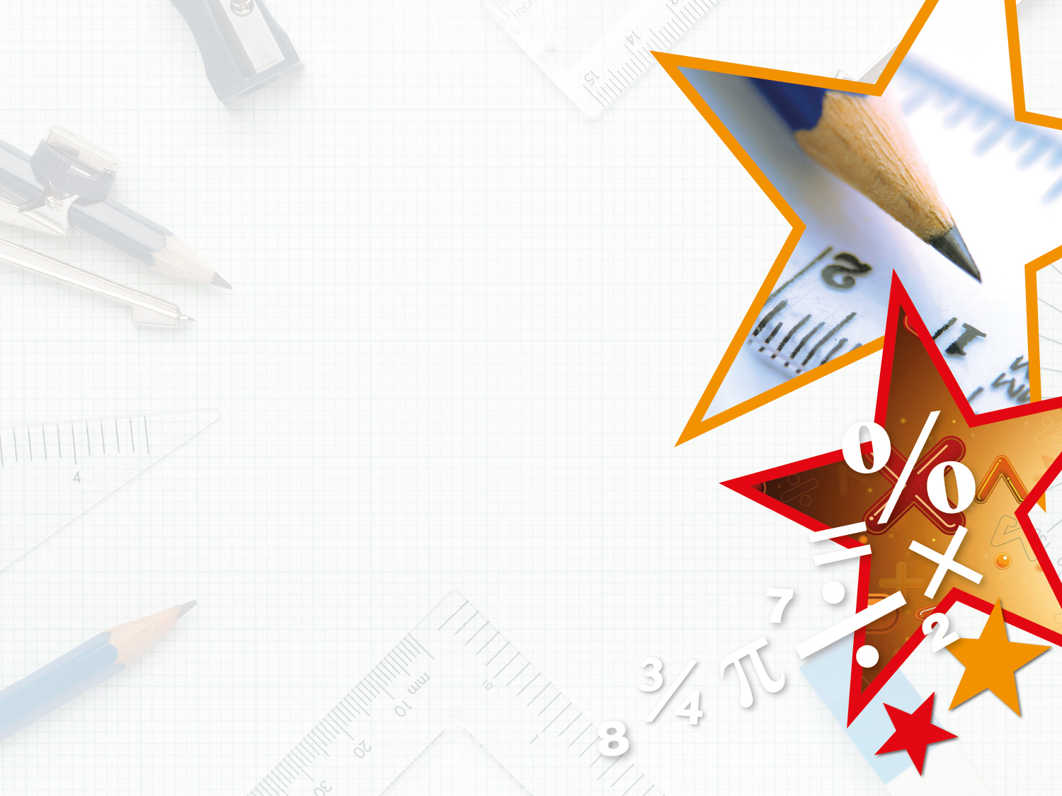


LIFE/work balance
We have started a #LIFEworkbalance campaign and we need your help to complete our LIFE/work balance survey.
We hope to publish the results soon, so please give 15 minutes of your time to help us get a true picture of school life.
Want to be a part of this campaign? Take the survey on our website and share it with your colleagues!
© Classroom Secrets Limited 2019

Slide 2
Year 2 – Autumn Block 1 – Place Value – Count Objects to 100
About This Resource:
This PowerPoint has been designed to support your teaching of this small step. It includes a starter activity and an example of each question from the Varied Fluency and Reasoning and Problem Solving resources also provided in this pack. You can choose to work through all examples provided or a selection of them depending on the needs of your class.
National Curriculum Objectives:
Mathematics Year 2: (2N2a) Read and write numbers to at least 100 in numerals and in words.
Mathematics Year 2: (2N3) Recognise the place value of each digit in a two digit number (tens, ones)
Mathematics Year 2: (2N4) Identify, represent and estimate numbers using different representations including the number line.
More Year 2 Place Value resources.
Did you like this resource? Don’t forget to review it on our website.
© Classroom Secrets Limited 2018

Slide 3
Year 2 – Autumn Block 1 – Place Value
Step 1:
Count Objects to 100
© Classroom Secrets Limited 2018

Slide 4
Introduction
Identify the missing numbers in each row.
1 | 2 |  | 4 |  | 6 |  |  | 9
eleven |  | twelve |  |  |  | fourteen
21 | 22 |  |  | 25 |  | 27 |  |  | 30
thirty-one |  | thirty-two |  |  |  |  |  | thirty-five
 | 42 | 43 |  |  | 46 |  | 48 | 49
© Classroom Secrets Limited 2018

Slide 5
Introduction
Identify the missing numbers in each row.
1 | 2 | 3 | 4 | 5 | 6 | 7 | 8 | 9 | 10
eleven |  | twelve |  | thirteen |  | fourteen |  | fifteen
21 | 22 | 23 | 24 | 25 | 26 | 27 | 28 | 29 | 30
thirty-one |  | thirty-two |  | thirty-three |  | thirty-four |  | thirty-five
41 | 42 | 43 | 44 | 45 | 46 | 47 | 48 | 49 | 50
© Classroom Secrets Limited 2018

Slide 6



Varied Fluency 1
Match each diagram to its number.
A
fifty- one
16
B
sixty
C
© Classroom Secrets Limited 2018

Slide 7
Varied Fluency 1
Match each diagram to its number.
A
fifty- one
16
B
sixty
C
© Classroom Secrets Limited 2018

Slide 8

Varied Fluency 2
What number is one more than
What number is one less than
?
?
© Classroom Secrets Limited 2018

Slide 9
Varied Fluency 2
What number is one more than
What number is one less than
63
64
© Classroom Secrets Limited 2018

Slide 10
Varied Fluency 3
Jasmine starts at eighty-three and counts
in ones on a number line.
What are the next four numbers she will say?
 | 83
© Classroom Secrets Limited 2018

Slide 11
Varied Fluency 3
Jasmine starts at eighty-three and counts
in ones on a number line.
What are the next four numbers she will say?
 | 83 |  |  | 84 |  |  | 85 |  |  | 86 |  |  | 87
© Classroom Secrets Limited 2018

Slide 12
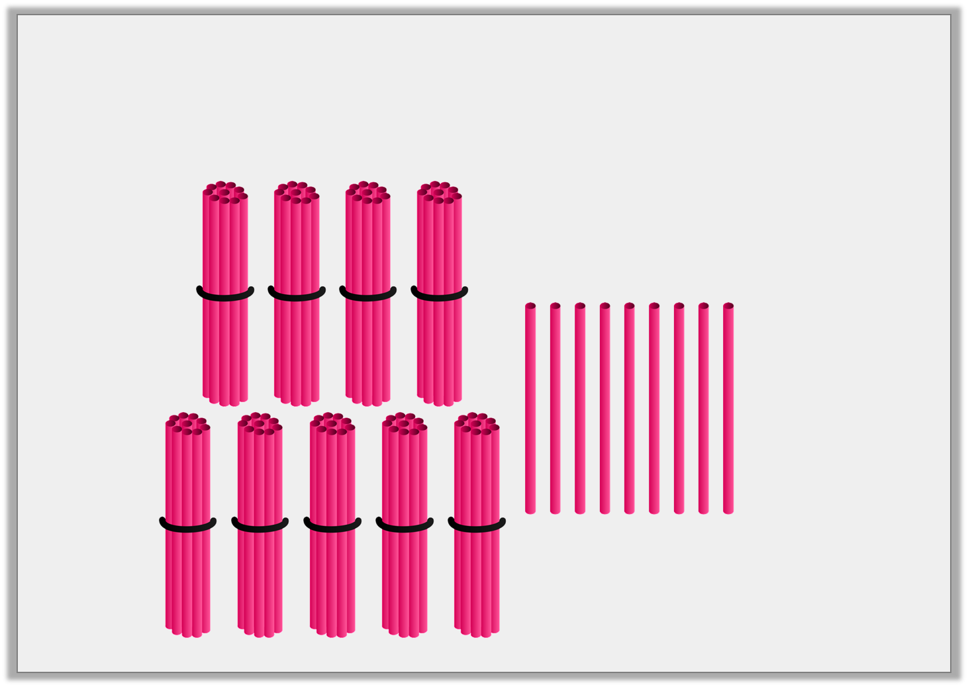
Varied Fluency 4
True or false? The number shown below is 89.
© Classroom Secrets Limited 2018

Slide 13
Varied Fluency 4
True or false? The number shown below is 89.
False. The number shown is 99.
© Classroom Secrets Limited 2018

Slide 14
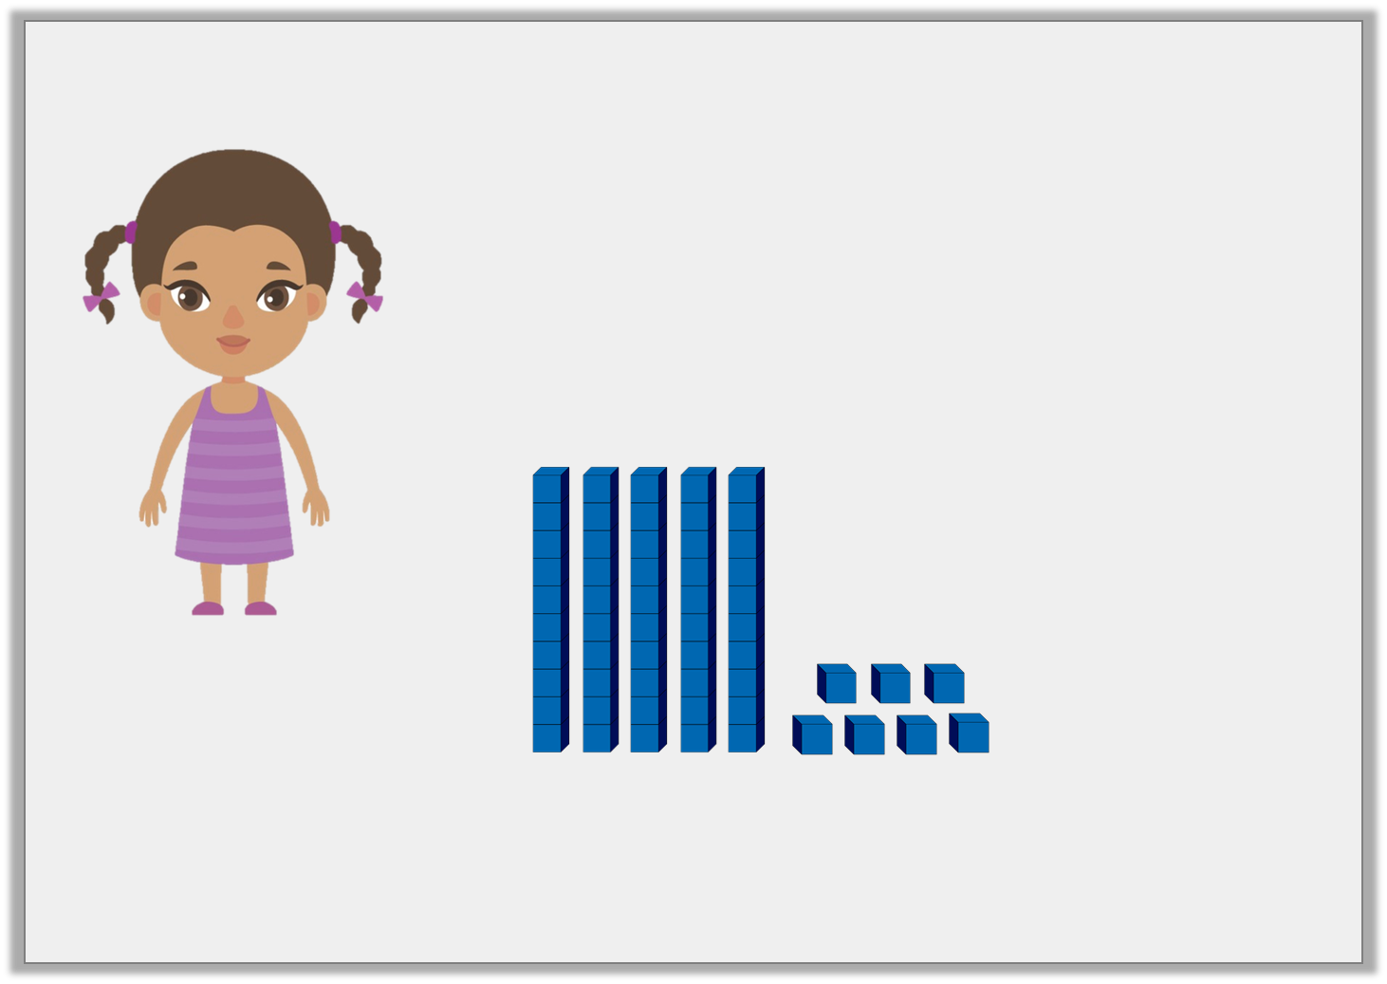
Reasoning 1
Do you agree with Jane?
Explain your answer.
The base 10 shows the number 47.
Jane
© Classroom Secrets Limited 2018

Slide 15
Reasoning 1
Do you agree with Jane?
Explain your answer.
Jane is incorrect because…
The base 10 shows the number 47.
Jane
© Classroom Secrets Limited 2018

Slide 16
Reasoning 1
Do you agree with Jane?
Explain your answer.
Jane is incorrect because there are 5 tens and 7 ones which makes 57, not 47.
The base 10 shows the number 47.
Jane
© Classroom Secrets Limited 2018

Slide 17
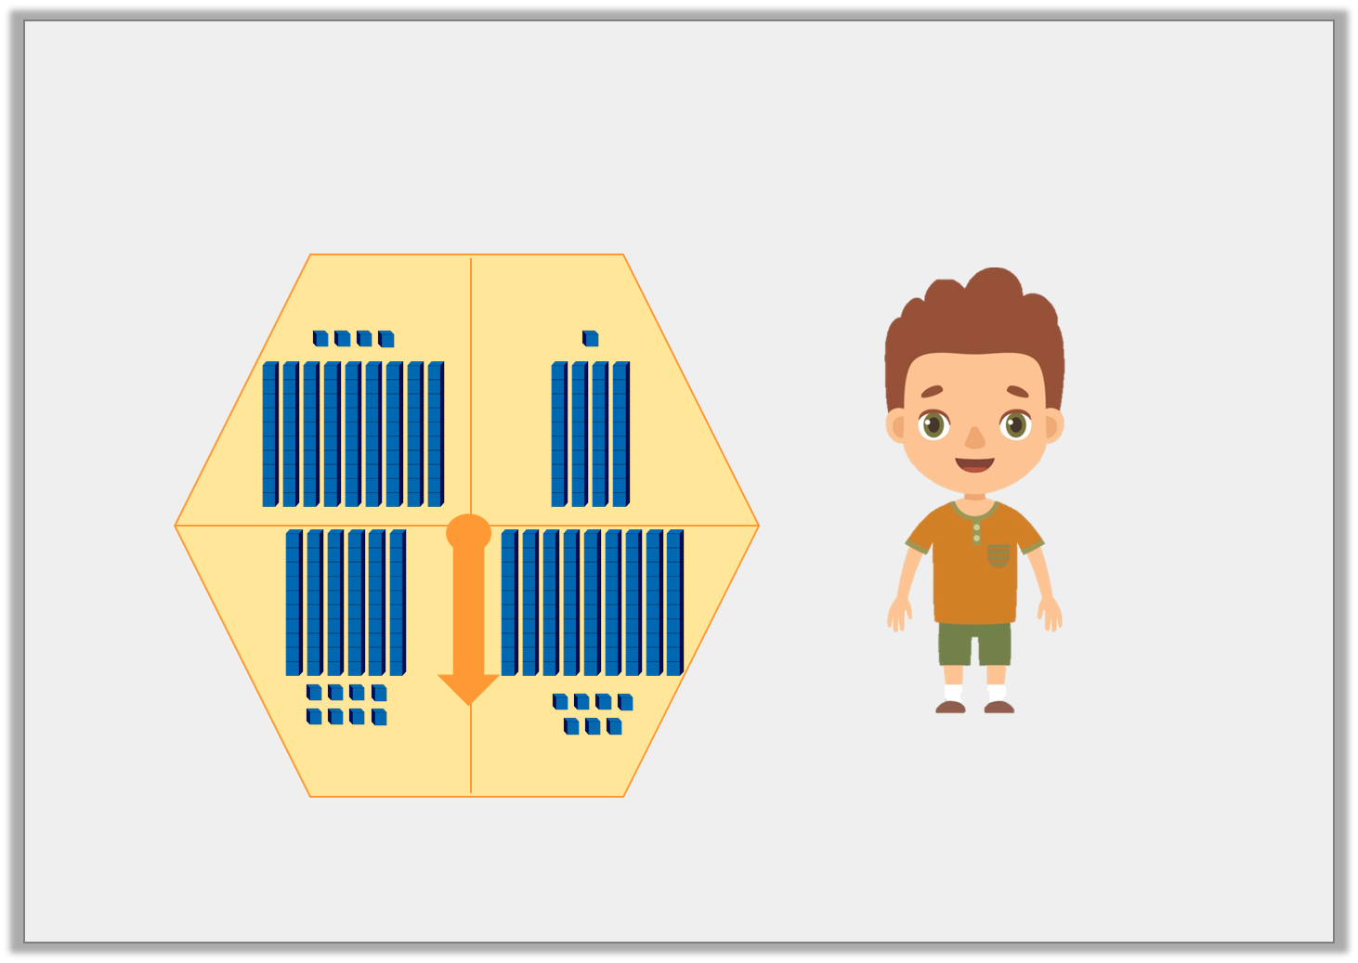
Problem Solving 1
If Derek spins the highest number on his spinner, what will the number be?
Derek
© Classroom Secrets Limited 2018

Slide 18
Problem Solving 1
If Derek spins the highest number on his spinner, what will the number be?
The highest number Derek can spin is 97.
Derek
© Classroom Secrets Limited 2018

Slide 19
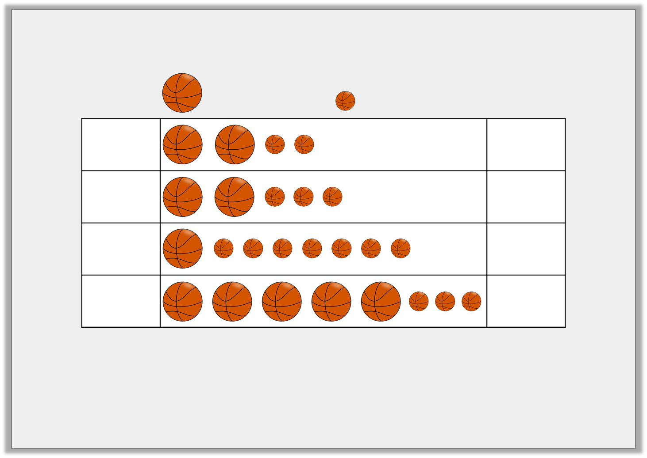
Reasoning 2
Johnny and his friends are practising their basketball skills.
Find and explain the errors in the pictogram.
= 10 points
= 1 point
Rick |  | 22
Tom |  | 32
Bella |  | 70
Freya |  | 53
© Classroom Secrets Limited 2018

Slide 20
Reasoning 2
Johnny and his friends are practising their basketball skills.
Find and explain the errors in the pictogram.
Tom’s number is incorrect because…
= 10 points
= 1 point
Rick |  | 22
Tom |  | 32
Bella |  | 70
Freya |  | 53
© Classroom Secrets Limited 2018

Slide 21
Reasoning 2
Johnny and his friends are practising their basketball skills.
Find and explain the errors in the pictogram.
Tom’s number is incorrect because the pictogram shows 2 tens and 3 ones which makes 23, not 32. The number for Bella is also incorrect as the pictogram shows 1 ten and 7 ones which makes 17, not 70.
= 10 points
= 1 point
Rick |  | 22
Tom |  | 32
Bella |  | 70
Freya |  | 53
© Classroom Secrets Limited 2018

