Slide 1
Complex Partitioning
Partitioning Numbers in Different Ways

Slide 2
Menu
Click the boxes to go to that section. Use the home buttons to return to this slide.
56
24
37
71
99
Tens and Unit Blocks
Tens and Unit Blocks
Tens and Unit Blocks
Tens and Unit Blocks
Tens and Unit Blocks
Bar Method
Bar Method
Bar Method
Bar Method
Bar Method
Number Shapes
Number Shapes
Number Shapes
Number Shapes
Number Shapes

Slide 3
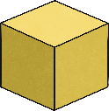
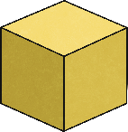
56
50
6
Home

Slide 4
56
40
16
Home

Slide 5
56
30
26
Home

Slide 6
56
20
36
Home

Slide 7
56
10
46
Home

Slide 8
56
50
6
40
16
30
26
20
36
10
46
Home

Slide 9
56
50
6
Home

Slide 10
56
40
16
Home

Slide 11
56
30
26
Home

Slide 12
56
20
36
Home

Slide 13
56
10
46
Home

Slide 14
24
20
4
Home

Slide 15
24
10
14
Home

Slide 16
24
20
4
10
14
Home

Slide 17
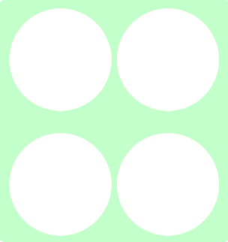
24
20
4
Home

Slide 18
24
10
14
Home

Slide 19
37
30
7
Home

Slide 20
37
20
17
Home

Slide 21
37
10
27
Home

Slide 22
37
30
7
20
17
10
27
Home

Slide 23
37
30
7
Home

Slide 24
37
20
17
Home

Slide 25
37
10
27
Home

Slide 26
71
70
1
Home

Slide 27
71
60
11
Home

Slide 28
71
50
21
Home

Slide 29
71
40
31
Home

Slide 30
71
30
41
Home

Slide 31
71
20
51
Home

Slide 32
71
10
61
Home

Slide 33
71
70
1
60
11
50
21
40
31
30
41
20
51
10
61
Home

Slide 34
71
70
1
Home

Slide 35
71
60
11
Home

Slide 36
71
50
21
Home

Slide 37
71
40
31
Home

Slide 38
71
30
41
Home

Slide 39
71
20
51
Home

Slide 40
71
10
61
Home

Slide 41
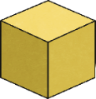
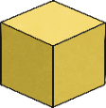
99
90
9
Home

Slide 42
99
80
19
Home

Slide 43
99
70
29
Home

Slide 44
99
60
39
Home

Slide 45
99
50
49
Home

Slide 46
99
40
59
Home

Slide 47
99
30
69
Home

Slide 48
99
20
79
Home

Slide 49
99
10
89

Slide 50
90
9
80
19
70
29
60
39
50
49
40
59
30
69
20
79
10
79
Home

Slide 51
99
90
9
Home

Slide 52
99
80
19
Home

Slide 53
99
70
29
Home

Slide 54
99
60
39
Home

Slide 55
99
50
49
Home

Slide 56
99
40
59
Home

Slide 57
99
30
69
Home

Slide 58
99
20
79
Home

Slide 59
99
10
89
Home

