Slide 1
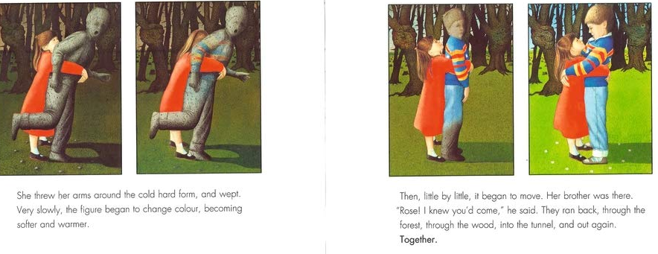
Read the rest of the story (The Tunnel ebook)
Why do you think he has turned to stone?
How do you think Rose felt when she saw her brother again? Can you find any words or phrases in the text to show this?
Why do you think he started to change colour?
Has the relationship between Rose and Jack changed? How do you know?
Is there a moral to the story?

